Slide 1


GM UNIVERSITY
Davanagere
PBL PRESENTATION ON
“ TRAVEL PLANNING APPLICATION ”
Presented by,
1.MOHAMMAD SULTAN MOMIN -
2.NOOTAN KUMAR K -
3.ROSHAN D N -
4.MOHINUDDIN HASSAN -
U25JE01AI068
U25JE01AI084
U25JE01AI104
U25JE01AI073
Guide Ms. BHOOMIKA B.R | PBL Coordinator Mr. MOHAMMAD ZEESHAN M | HOD Dr. Asha K
B.E, M.Tech
1

Slide 2

CONTENTS
1. Abstracts
2. Introduction
3. Problem statement
4. Objectives
5. Methodology
6. Software and hardware specifications

Slide 3
ABSTRACT
This project showcases the frontend development of a Travel Planning Application using core web technologies—HTML, CSS, and JavaScript—alongside Canva for visual design elements. The application is designed to assist users in organizing their travel experiences through an interactive and user-friendly interface.
Key features include itinerary creation, budget tracking, booking overview, and local discovery modules. The layout is structured with semantic HTML, styled using responsive CSS for cross-device compatibility, and enhanced with JavaScript to enable dynamic interactions such as form validation, tab switching, and real-time updates.
This frontend implementation provides a practical and visually engaging solution for travelers seeking to streamline their planning process.

Slide 4
INTRODUCTION
In today’s fast-paced world, travel has evolved from a luxury to a lifestyle—whether for leisure, business, or exploration. Yet, planning a trip remains a complex and often overwhelming task, involving multiple layers of decision-making, coordination, and organization. This project introduces a Travel Planning Application, a web-based solution designed to simplify and enhance the travel planning experience through a visually engaging and interactive frontend interface.
Built entirely using HTML, CSS, and JavaScript, the application focuses on delivering a seamless user experience without relying on external frameworks or libraries. It leverages the power of pure web technologies to create a responsive, intuitive, and aesthetically pleasing platform that guides users through every stage of their journey—from selecting destinations to managing budgets and discovering local attractions.

Slide 5
PROBLEM STATEMENT
Planning a trip involves juggling multiple tasks—booking, budgeting, itinerary creation, and local discovery—often across different platforms. This can be time-consuming and confusing, especially for non-technical users.
This project aims to solve that by building a simple, responsive, and visually appealing travel planning interface using HTML, CSS, JavaScript, and Canva. It offers core features like itinerary management, budget tracking, and booking overview—all in one place, without relying on backend systems or external libraries.

Slide 6
OBJECTIVES
Create a cohesive visual design system using Canva to produce custom icons, banners, and UI elements that reflect the theme of travel and exploration.
Implement an itinerary builder that allows users to create, view, and edit daily travel plans with ease.
Develop a budget tracking module to help users input expenses, monitor spending, and stay within their travel budget.
Design a booking overview section to organize flight, hotel, and transport details in a clear and accessible format.
Integrate a local discovery panel showcasing attractions, restaurants, and cultural experiences tailored to the user’s destination.

Slide 7
SOFTWARE REQUIREMENTS
1. Code Editor
Visual Studio Code (VS Code) – Recommended for writing and organizing HTML, CSS, and JavaScript files.
2. Web Browser
Google Chrome, Mozilla Firefox, or Microsoft Edge – For testing and debugging your application.
3. Design Tool
Canva – Used to create UI mockups, icons, banners, and other visual assets.
4. Version Control
GitHub – To host your project repository and collaborate (optional but useful).
5. Local Server (Optional for Testing)
Live Server Extension (in VS Code) – Automatically reloads your app when you save changes.
6. Browser Developer Tools
Built-in DevTools in Chrome/Firefox – For inspecting elements, debugging JavaScript, and testing responsiveness.

Slide 8
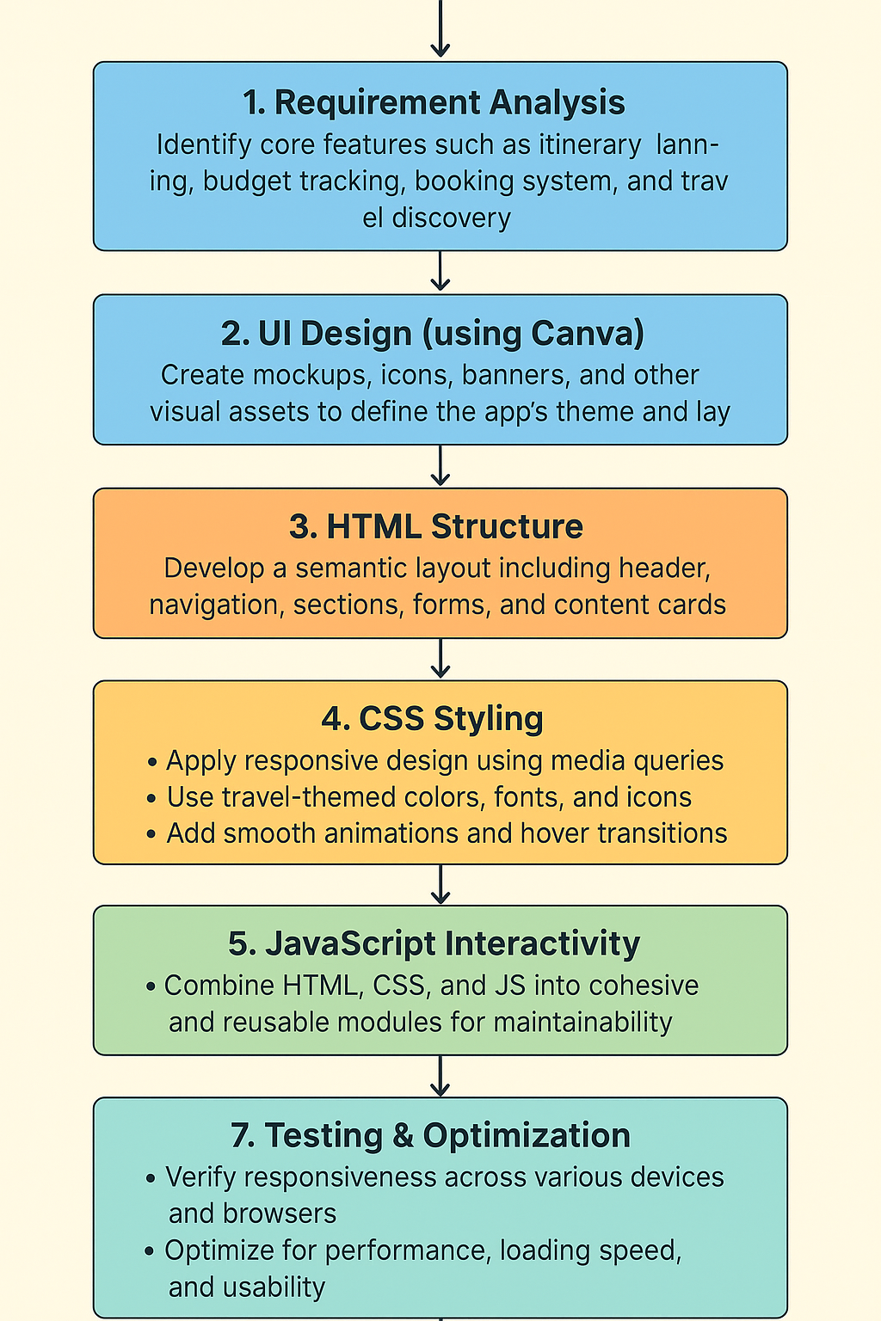
METHODOLOGY

Slide 9

Thank you all
12

